Slide 1
EDA Analysis Beer and Breweries Budweiser
Presented by: Carlos Estevez and Haitie Liu

Slide 2
Introduction
In this EDA(Exploratory Data Analysis) we will conduct an analysis about beers sold across different states in the United States
Show the different beer styles managed by each brewery in each state
In this analysis we will focus on the different business areas that the Budweiser corporation could improve: Customer service and Stock availability
Strengthen their Budweiser’s position in the market and translating these benefits to the final customer

Slide 3
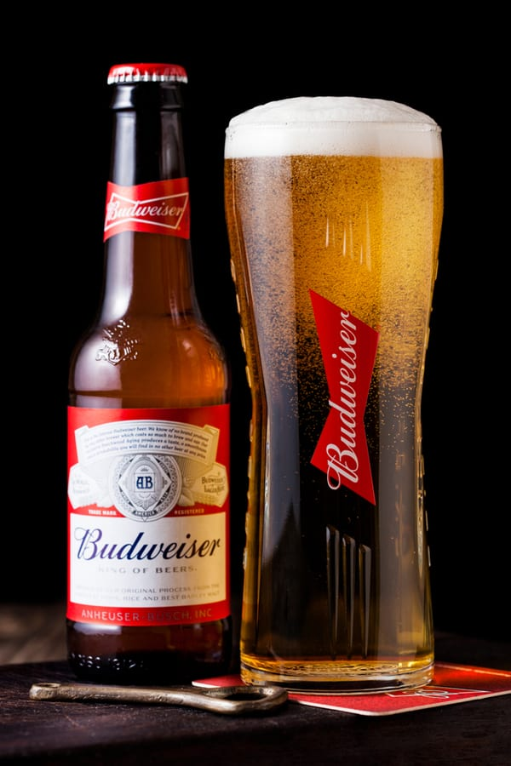
Important facts
Budweiser is an American-style pale lager
Americans were mostly drinking heavy in the 1850s
Budweiser created refreshing light lager perfect for hot summers
Budweiser is classified as an American lager
Image 1: Budweiser beer

Slide 4
IBU and ABV
Two characteristics used to describe styles : Alcohol by volume (ABV) and international bitterness unit (IBU)
ABV represents the percentage of alcohol in the beer
Beers with a higher ABV have a more bitter flavor
IBU is a measurement of the number of bitter flavor compounds in a beer.
The IBU scale fall between 5 IBUs and 120 IBUs. Anything higher than 120 can't be detected by the average palate
Notes:
Haitie Liu

Slide 5

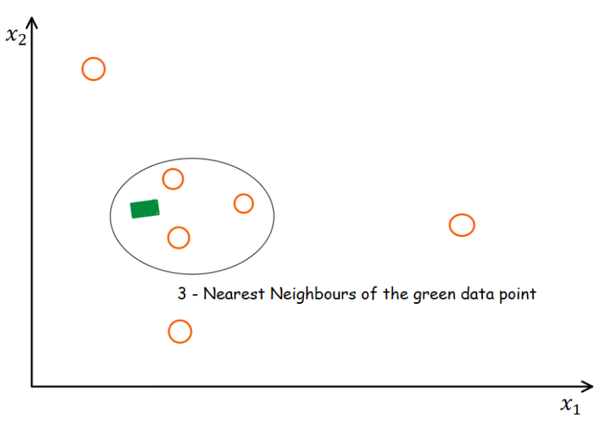
Analysis of missing values
Data Cleaning is one of the important steps in an EDA
Handling missing values is part of the Data Cleansing activities
A missing value is a data value that is not captured nor stored in our dataset
Missing values datasets
Dataset DF_Beers: ABV:62 missing values,IBU: 1005 missing values
Approaches to deal with the missing values in our dataset
ABV🡪Replacing missing values using Mean
IBU🡪Replacing missing values using KnnImputation
KnnImputer utilizes the k-Nearest Neighbors method to replace the missing values
Image 1: Data Cleansing
Image 2: KNN Imputation IBU

Slide 6
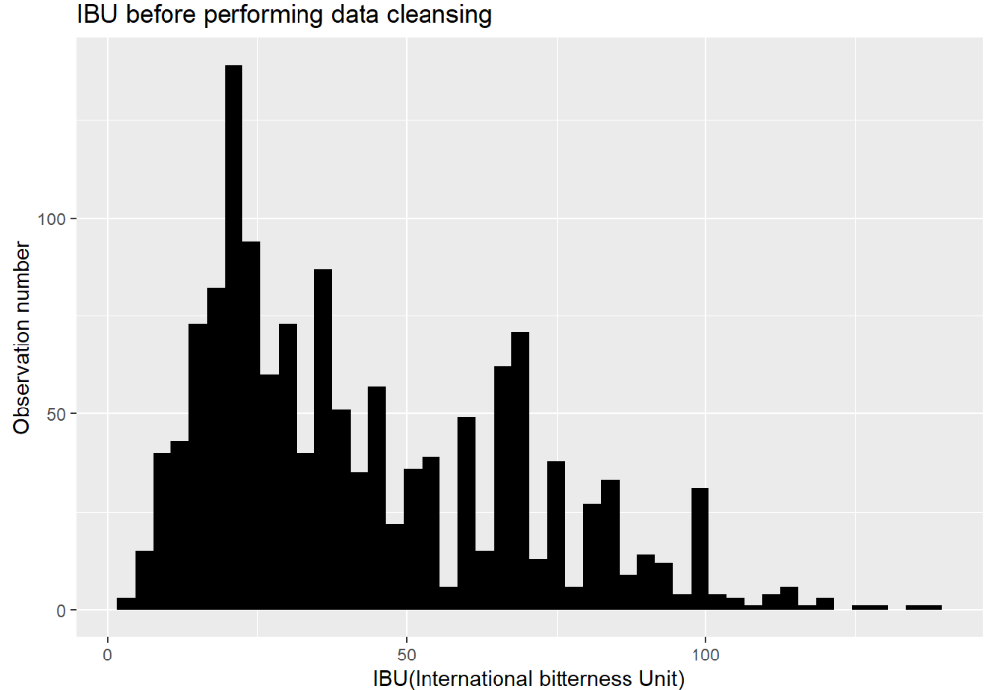
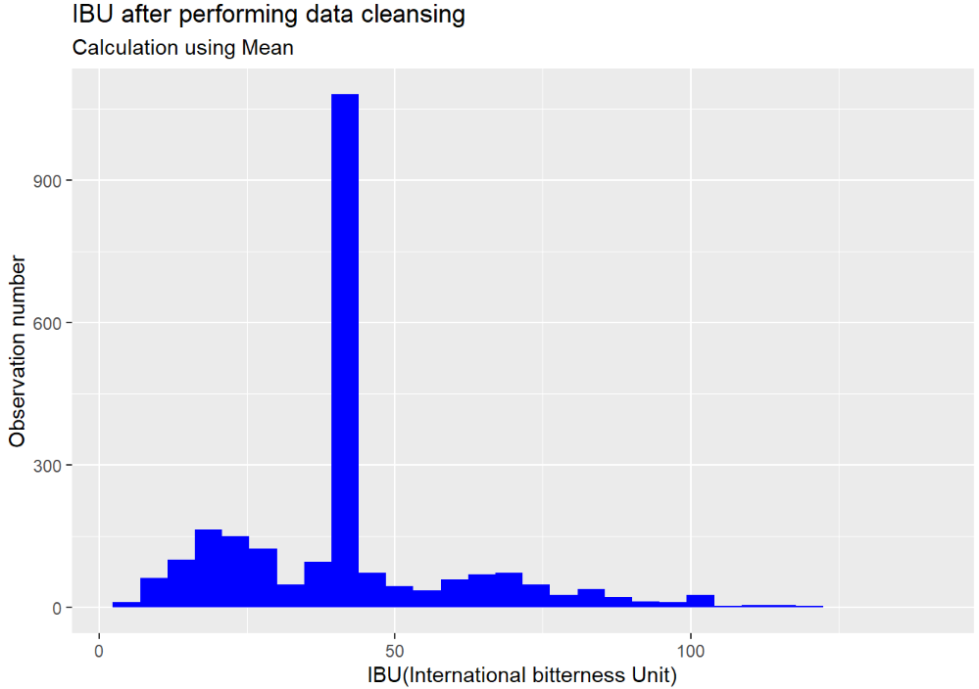
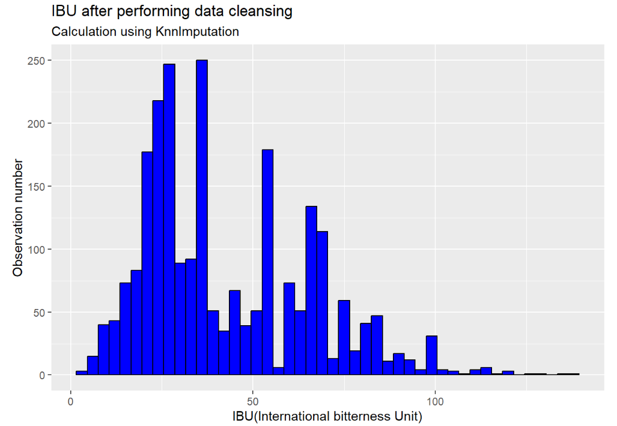
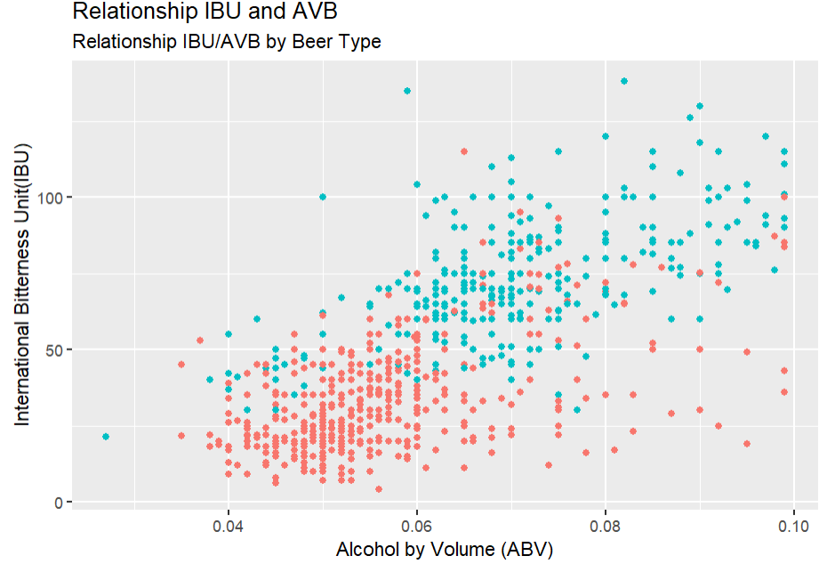
Analysis of missing values
IBU Analysis Missing values
Large number missing values
Ignoring missing values is not an option
Replacing missing values with the mean is a bad idea
Find a sophisticated method to deal with this problem
There’s a positive relationship between IBU and ABV
KNN imputation method to replace missing values with more plausible values
The resulting distribution is very similar to the original
Bad idea
Great
Notes:
IBU Replacing missing values
There are a large number missing observations when it comes to IBU. We need to find a sophisticated method to deal with this problem. If we tried to ignore these observations, that will be a bad idea since we will lose half of the dataset
If we try to replace them with the Mean as we did with ABV it will be also a terrible idea. Look at blue plot
The idea in kNN methods is to identify ‘k’ samples in the dataset that are similar or close in the space. Then we use these ‘k’ samples to estimate the value of the missing data points
It is important that we find a relationship between IBU with another variable in the dataset. We think IBU and ABV are related
The final results look very good when we compare the resulting distribution with the original

Slide 7
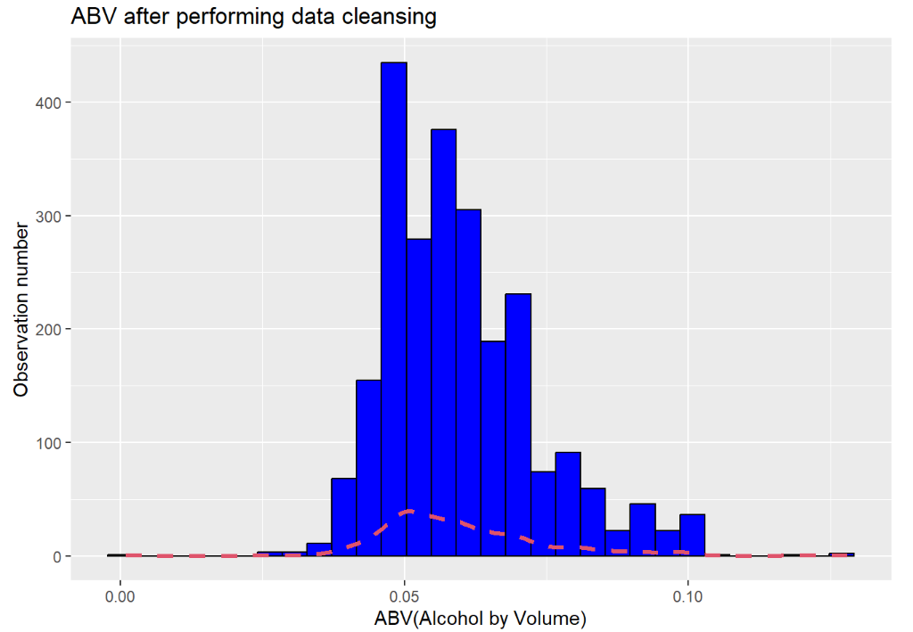
Summary statistics and distribution ABV
Summary statistics and distribution ABV
This is a moderately right skewed distribution
The Mean is slightly greater than the Median
Statistical Summary
Kurtosis: 1.24
Skewness: 0.9698
Notes:
Summary statistics and distribution ABV
It seems that the distribution is moderately skewed however, it tends to be normal
As a general rule of thumb: If skewness is less than -1 or greater than 1, the distribution is highly skewed. If skewness is between -1 and -0.5 or between 0.5 and 1, the distribution is moderately skewed. If skewness is between -0.5 and 0.5, the distribution is approximately symmetric
The values for asymmetry and kurtosis between -2 and +2 are considered acceptable in order to prove normal univariate distribution (George & Mallery, 2010)
It might seem that it is a moderately a right skewed distribution because what the plot suggests, however the Mean is slightly less than the Median , so we might also think that the data points are normally distributed

Slide 8
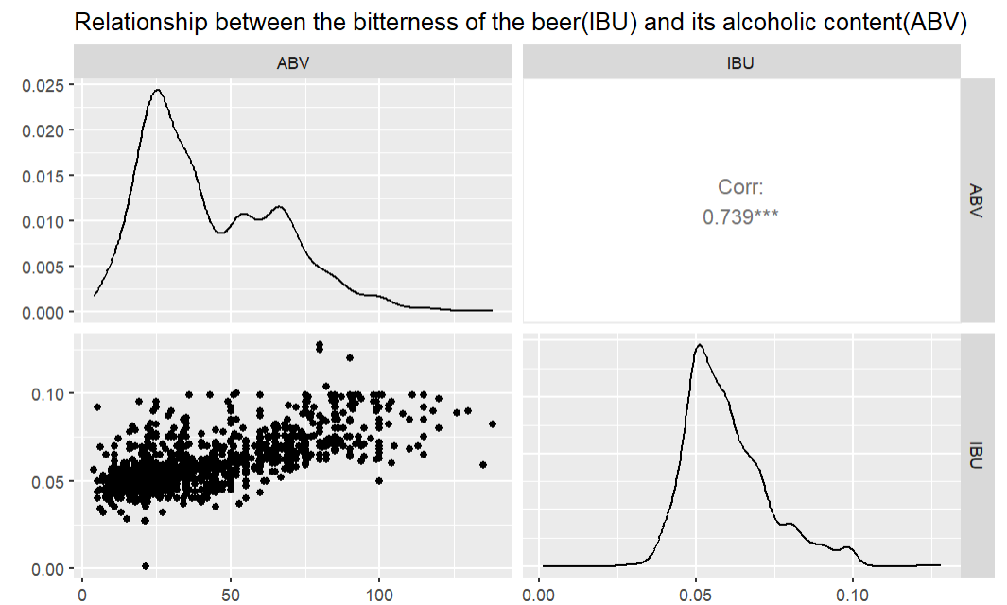
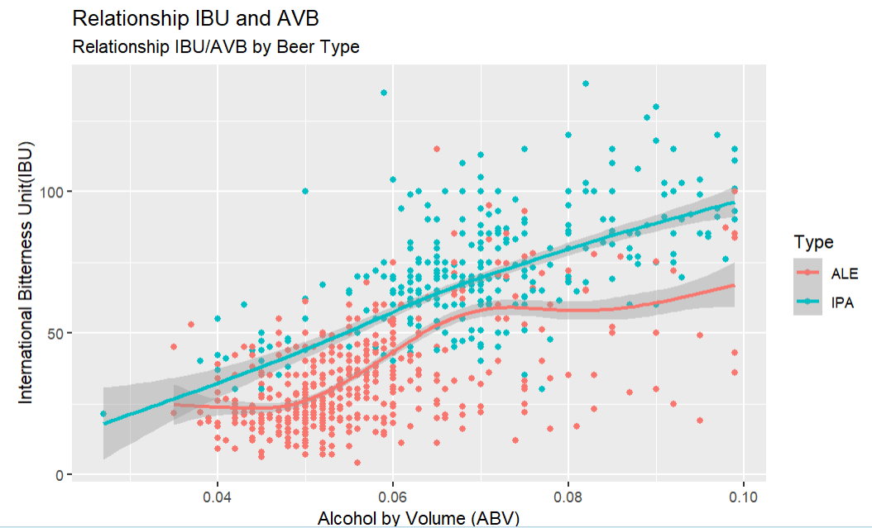
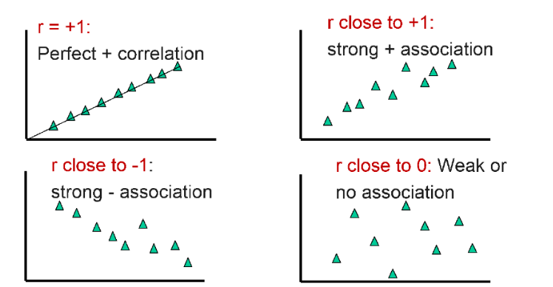
Relationship between IBU and ABV
Relationship between IBU and ABV
There’s a strong positive linear relationship between IBU and ABV
IPAs tend to have higher ABV and IBU
The correlation coefficient also confirms the linear relationship
Notes:
Relationship between IBU and ABV
As the data suggests there’s a positive linear relationship between IBU and ABV. As ABV increases so does IBU
At the beginning of the document we presented this information from the Budweiser website: “When it comes down to it, a Pale Ale should have a nice hop character but medium build, whereas IPAs tend to have higher ABV and IBU”
This last statement complements what the data is reflecting. IBU and ABV are proportionally related
The correlation coefficient also confirms the linear relationship

Slide 9
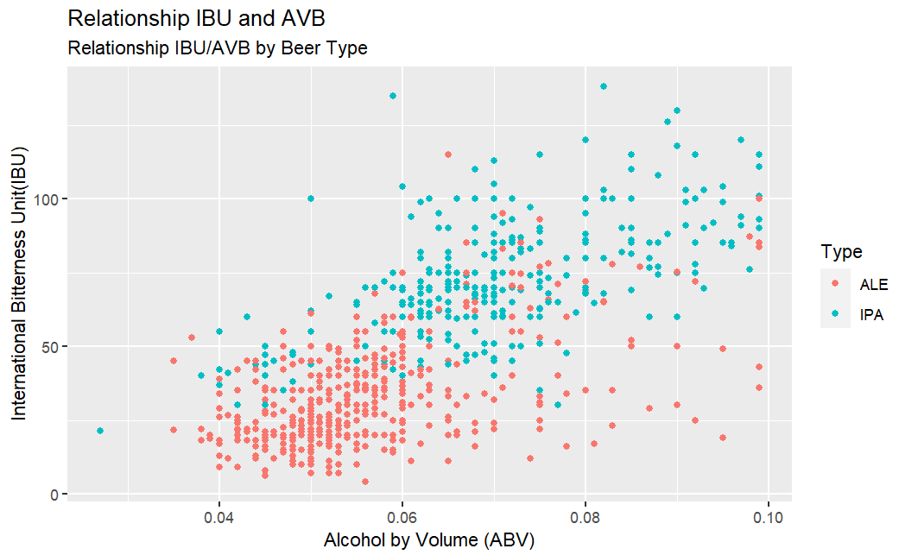
Difference between IPA and PALE Beer types
Difference between IPA and PALE
IPA beer types high level of IBU and ABV
ALE beer types less level of IBU and ABV
Pale ales will usually be between 4.5 – 6.2% ABV
IPAs sit between 5 – 7.5% (or more for a double IPA, 7.5 – 10.0%)
Notes:
As we can see from the image the observations of the IPA beer types have higher level of bitterness and alcohol
And the opposite is also true. The ALE Beer Types have less level of IBU and ABV
At the beginning of the presentation we also highlighted the differences between ALE and IPA.
“Pale ales will usually be between 4.5 – 6.2% ABV, where IPAs will usually sit somewhere between 5 – 7.5% (or more for a double IPA, 7.5 – 10.0%). IPAs may also be slightly more bitter, but there is a wide range here”
We also can use KNN to verify that this is true

Slide 10
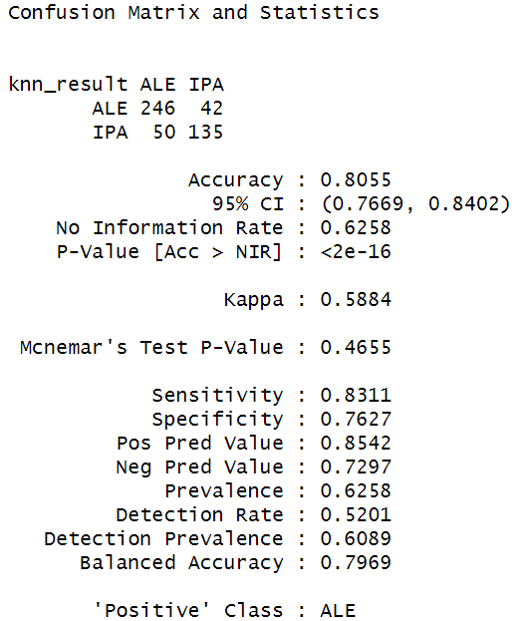
Difference between IPA and PALE Beer types
Using KNN to proof difference:
The accuracy of KNN is very high
There’s a clear difference between IPA beers and the rest
KNN easily can classify when a beer is IPA or a beer is a Pale
Both group have a clear difference of bitterness and alcohol
Notes:
KNN Results
As we can see from the image, the accuracy of KNN is very high, almost 80%. That means there’s a clear difference between IPA beers and the rest
Giving the fact that KNN showed a high accuracy using IBU and ABV, all it means that KNN easily can classify when a beer is IPA or a beer is a Pale . In that sense, both group have a clear difference when it comes to the level of bitterness and alcohol, and KNN could easily identified this difference

Slide 11
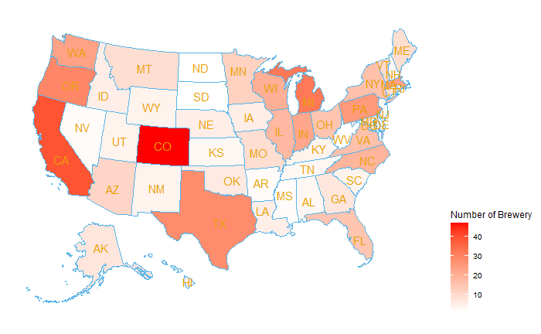
How many breweries are
in each state
Colorado: 47
California:39
Michigan:32
Oregon:29
Texas:28
The Big 5:
Accounts for 32% of craft breweries in the United States, producing whopping close to 50% of all known craft beers in the country!
These States are beer powerhouse!

Slide 12
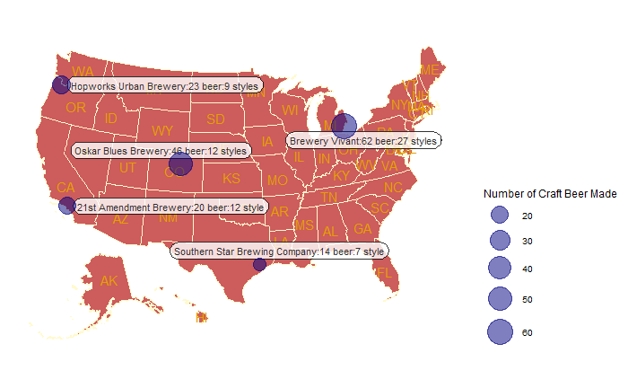
The Top Breweries The Big 5
1.Brewery Vivant, MI : 62 beer,27 styles
2.Oskar Blues Brewery, CO : 46 beer,12 styles
3.Hopworks Urban Brewery, OR : 23 beer,9 styles
4.21st Amendment Brewery, CA : 20 beer,12 style
5.Southern Star Brewing Company, TX : 14 beer,7 style
If we are planning an acquisition, Brewery Vivant is definitely worth looking at

Slide 13
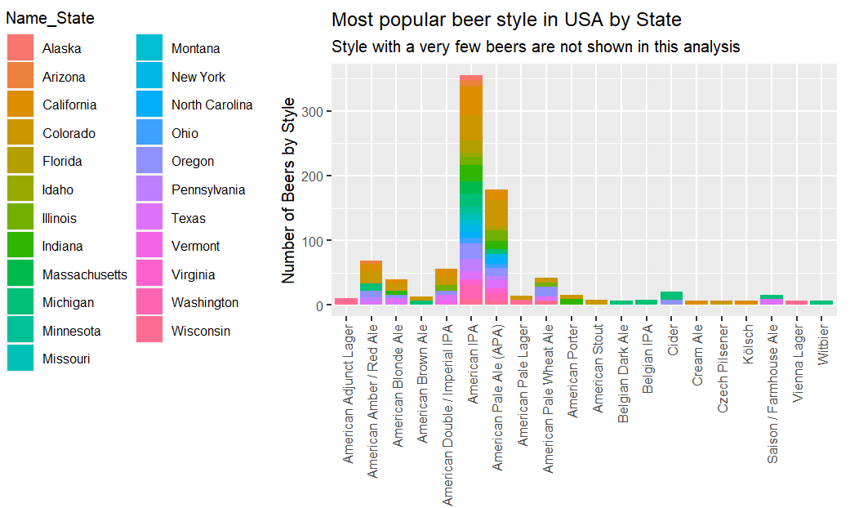
Analysis of Beer Assortment
by State

Slide 14
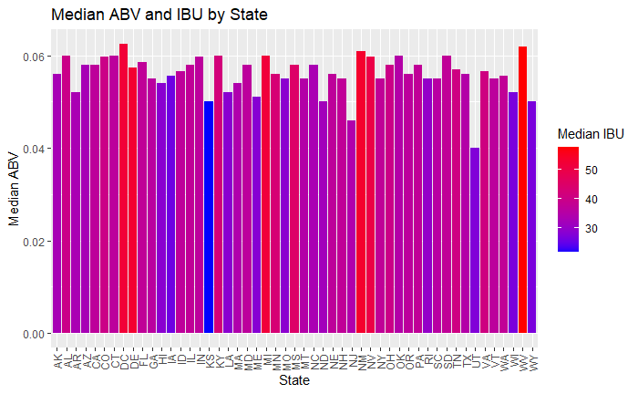
Median ABV AND IBU by State
KS has the lowest Median IBU, while WV has the highest Median IBU.
Utah has the lowest Median ABV, while DC has the highest median ABV.
It is interesting that West Virginia has both the highest IBU and ABV

Slide 15
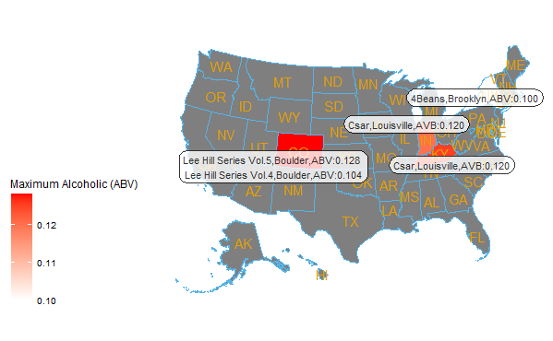
Top 5 ABV Beer In Each State
1.Lee Hill Series Vol. 5 - Belgian Style Quadrupel Ale
From Boulder,Colorado
ABV:0.128
2. London Balling
From:Evansville,Kentucky
ABV:0.125
3. Csar
From: Louisville,Indiana
AVB:0.120
4. Lee Hill Series Vol. 4 - Manhattan Style Rye Ale
From: Boulder,Colorado
ABV:0.104
5. 4Beans
From: Brooklyn, New York
ABV:0.100

Slide 16
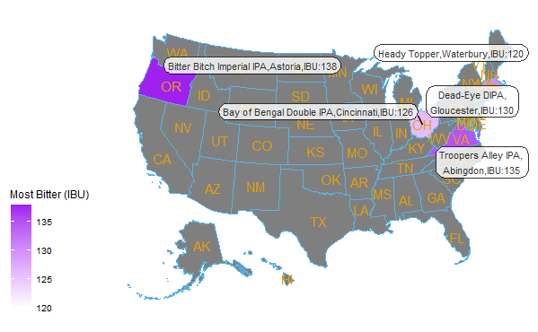
Top 5 IBU Beer In Each State
1.Bitter Bitch Imperial IPA
From Astoria,Oregon
IBU:138
2. Troopers Alley IPA
From:Abingdon,VA
IBU:135
3. Dead-Eye DIPA
From: Gloucester,MA
IBU:130
4.Bay of Bengal Double IPA (2014)
From: Cincinnati,OH
IBU:126
5. Heady Topper
From: Waterbury,VT
IBU:120

Slide 17
Thank You!
Carlos Estevez:
Video Presentation:
https://www.youtube.com/watch?v=iuUFhSnSK4k
cestevez@smu.edu
Haitie Liu:
Video Presentation:
https://www.youtube.com/watch?v=E9V3VX5xglI
haitiel@mail.smu.edu

